Slide 1


ECMAScript 6
& TypeScript
-- PART 2 --
copyright 2016 Trainologic LTD

Slide 2

ECMAScript 6 & TypeScript
Enumerable Types
Modules
Types
Classes
Iterators
Generators
Promises
Maps, Sets & Friends
Enums
copyright 2016 Trainologic LTD

Slide 3

ECMAScript 6 & TypeScript
Enums
A way to organize a collection of related values
Enum members have numeric values associated with them and can be either constant or computed
TS Only. JS does not provide enums
Enums are number based
Syntax:
enum EnumName {
elem1 [= initializer1],
elem2 [= initializer2],
…
elemN [= initializerN]
}
copyright 2016 Trainologic LTD

Slide 4
ECMAScript 6 & TypeScript
Example
enum Characters {
WalterWhite,
SkylerWhite,
SaulGoodman,
JessePinkman,
GusFring
}
var main = Characters.WalterWhite;
console.log(main); // 0
console.log(main === Characters.WalterWhite); // true
copyright 2016 Trainologic LTD

Slide 5
ECMAScript 6 & TypeScript
Enum Values
Enum members have numeric values associated with them
Generally:
  First element receives a default value of 0
  Other elements receive previous element’s value + 1
  Multiple elements can have same value
However values can also be computed:
  Expressions evaluating to a number
  Expressions using previous members
  Function calls
Some computed values are known & defined at compile time, others only at runtime (e.g. function calls)
copyright 2016 Trainologic LTD

Slide 6
ECMAScript 6 & TypeScript
Example
Object
  1:"SkylerWhite"
  2:"SaulGoodman"
  20:"JessePinkman"
  99:"GusFring"
  GusFring:99
  JessePinkman:20
  SaulGoodman:2
  SkylerWhite:1
  WalterWhite:1
function getGusValue() {
return 99;
}
enum Characters {
WalterWhite = 1,
SkylerWhite = WalterWhite, // also 1
SaulGoodman, // = 2 (prev + 1)
JessePinkman = 10 * SaulGoodman,
GusFring = getGusValue()
}
console.dir(Characters);
copyright 2016 Trainologic LTD

Slide 7
ECMAScript 6 & TypeScript
Which Transpiles to…
function getGusValue() {
return 99;
}
var Characters;
(function (Characters) {
Characters[Characters["WalterWhite"] = 1] = "WalterWhite";
Characters[Characters["SkylerWhite"] = 1] = "SkylerWhite";
Characters[Characters["SaulGoodman"] = 2] = "SaulGoodman";
Characters[Characters["JessePinkman"] = 20] = "JessePinkman";
Characters[Characters["GusFring"] = getGusValue()] = "GusFring";
})(Characters || (Characters = {}));
console.dir(Characters);
copyright 2016 Trainologic LTD

Slide 8
ECMAScript 6 & TypeScript
Const Enums
TS generated an object with both forward (name -> value) and reverse (value -> name) mappings, as we’ve seen earlier
References to enum members are always emitted as property accesses, example:
  console.log(Characters.JessePinkman);
For a performance boost we can create const enums
Const enum references use inline values
  But then we can’t use computed members ☹
copyright 2016 Trainologic LTD

Slide 9
ECMAScript 6 & TypeScript
Example
  const enum Characters {
  WalterWhite = 1,
  SkylerWhite = WalterWhite,
  SaulGoodman,
  JessePinkman = 10 * SaulGoodman,
  // sorry, no computed values allowed ☹ */
  GusFring = 99 /* getGusValue() */
  }
  console.log(Characters.JessePinkman);
copyright 2016 Trainologic LTD

Slide 10
ECMAScript 6 & TypeScript
Which Transpiles to…
  // no enum object created
  // values are inlined
  console.log(20 /* JessePinkman */);
copyright 2016 Trainologic LTD

Slide 11
ECMAScript 6 & TypeScript
Browser Compatibility
This is a TypeScript specific feature not supported natively by JS
copyright 2016 Trainologic LTD

Slide 12
ECMAScript 6 & TypeScript
Enumerable Types
Modules
Types
Classes
Iterators
Generators
Promises
Maps, Sets & Friends
Modules
copyright 2016 Trainologic LTD

Slide 13
ECMAScript 6 & TypeScript
Modules
Before ES6, JS did not have modules, and so libraries were used instead. Now, ES6 finally introduced modules.
Modules are executed within their own scope: declarations do not pollute the global namespace
Modules are stored in files: one module per file
Module name is the file name (w/o extension)
The export and import statements are used to import/export module declarations respectively
Two export types exist: named and default
  Named exports are useful to export several values
  Default exports are considered the “main” exported module value. Limited to single default per module.
copyright 2016 Trainologic LTD

Slide 14
ECMAScript 6 & TypeScript
Example – Named Exports
  /* calculator.js */
  const COEFFICIENT = 42;
  export function calculate(x, y) {
  return x + COEFFICIENT * y;
  }
  export { COEFFICIENT };
  /* application.js */
  import { calculate, COEFFICIENT } from "./calculator";
  console.log(calculate(10, 20)); // 42
  console.log(COEFFICIENT); // 850
copyright 2016 Trainologic LTD

Slide 15
ECMAScript 6 & TypeScript
Example – Default Exports
  /* calculator.js */
  const COEFFICIENT = 42;
  export default function calculate(x, y) {
  return x + COEFFICIENT * y;
  }
  /* application.js */
  import calculate from "./calculator"; // no curly braces around calculate
  console.log(calculate(10, 20)); // 850
copyright 2016 Trainologic LTD

Slide 16
ECMAScript 6 & TypeScript
A Word about Module Loaders
As we’ve seen, modules can import/use one another
The actual module files loading is performed by a module loader, responsible for:
  Locating the module files
  Fetching/loading them into memory
  Handling module dependencies
  Executing their code
This is usually done in runtime (although can be done in compile time e.g. for dist bundling)
Common module loaders include requirejs and systemjs
copyright 2016 Trainologic LTD

Slide 17
ECMAScript 6 & TypeScript
TS & Modules
TS needs to know which module loader we will be using, as the compilation output differs for each one
We define it using the compiler module option:
We will now see how TS transpiles modules to be used for commonjs
  // tsconfig.json
  {
  "compilerOptions": {
  "target": “es6",
  "module": "commonjs“ // other options: amd, system, es6, umd
  }
  }
copyright 2016 Trainologic LTD

Slide 18
ECMAScript 6 & TypeScript
Modules & TS – Named Exports
  /* calculator.js */
  var COEFFICIENT = 42;
  exports.COEFFICIENT = COEFFICIENT;
  function calculate(x, y) {
  return x + COEFFICIENT * y;
  }
  exports.calculate = calculate;
  /* application.js */
  var calculator_1 = require("./calculator");
  console.log(calculator_1.calculate(10, 20));
  console.log(calculator_1.COEFFICIENT);
copyright 2016 Trainologic LTD

Slide 19
ECMAScript 6 & TypeScript
Modules & TS – Default Exports
  /* calculator.js */
  var COEFFICIENT = 42;
  function calculate(x, y) {
  return x + COEFFICIENT * y;
  }
  // module mode marker for interoperability
  Object.defineProperty(exports, "__esModule", { value: true });
  exports.default = calculate; // actual exported default value
  /* application.js */
  var calculator_1 = require("./calculator");
  console.log(calculator_1.default(10, 20)); // imported as “default”
copyright 2016 Trainologic LTD

Slide 20
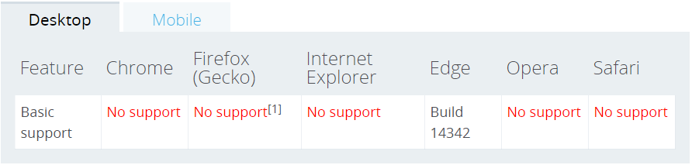
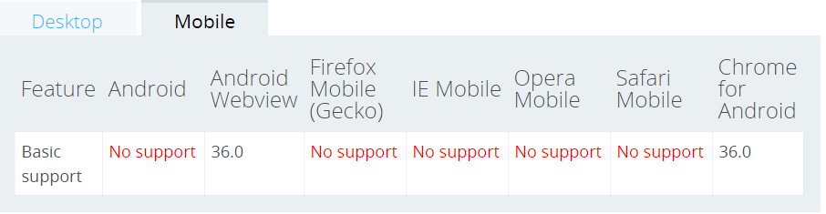
ECMAScript 6 & TypeScript
Browser Compatibility - import
copyright 2016 Trainologic LTD

Slide 21
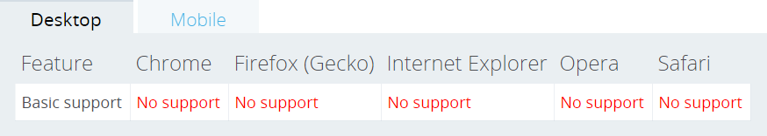
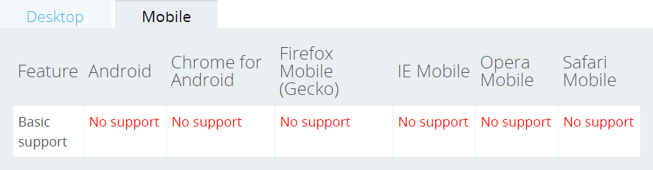
ECMAScript 6 & TypeScript
Browser Compatibility - export
copyright 2016 Trainologic LTD

Slide 22
ECMAScript 6 & TypeScript
Enumerable Types
Modules
Types
Classes
Iterators
Generators
Promises
Maps, Sets & Friends
Types
copyright 2016 Trainologic LTD

Slide 23
ECMAScript 6 & TypeScript
Types
One of the main goals/reasons for using TypeScript
Types enhance code quality and understandability, and allow us to catch errors at compile time
JS natively has six (6) primitive data types:
  string
  number
  boolean
  null
  undefined
  symbol ← new in ES6
TS uses these (and more e.g. interfaces, classes, arrays, …) for its typing system
copyright 2016 Trainologic LTD

Slide 24
ECMAScript 6 & TypeScript
Implicit Typing
TS does not force using types; they are intentionally optional
Any plain JS can be renamed .js -> .ts an will still compile
TS attempts to infer types from the code and provide compile time type safety
However, using explicit types (next slide) greatly improve TS’s ability to warn us of potential errors/bugs
var mynumber = 42; // TS implicitly infers type number
mynumber = "great number“; // assignment of a string value into a number typed var
// will compile but raise a compile time error
// Error: TS2322: Type 'string' is not assignable to type 'number'.
copyright 2016 Trainologic LTD

Slide 25
ECMAScript 6 & TypeScript
Explicit Typing
The basic type annotations are as follows:
Anything that is available in the type declaration space can be used as a type annotation
The declaration space includes JS primitive types, interfaces, enums, functions, classes, arrays
var base: number = 123;
function multiply (num: number): number {
return base * num;
}
copyright 2016 Trainologic LTD

Slide 26
ECMAScript 6 & TypeScript
Primitives & Arrays
var num: number;
var str: string;
var bool: boolean;
num = 123;
num = 123.456;
num = '123'; // Error
str = '123';
str = 123; // Error
bool = true;
bool = false;
bool = 'false'; // Error
var boolArray: boolean[];
boolArray = [true, false];
console.log(boolArray[0]); // true
console.log(boolArray.length); // 2
boolArray[1] = true;
boolArray = [false, false];
boolArray[0] = 'false'; // Error!
boolArray = 'false'; // Error!
boolArray = [true, 'false']; // Error!
copyright 2016 Trainologic LTD

Slide 27
ECMAScript 6 & TypeScript
Interfaces
TS’s primary way for composing multiple type annotations into a single named annotation
  interface Name {
  first: string;
  second: string;
  }
  var name: Name;
  name = { first: 'John', second: 'Doe’ }; // Okay
  name = { first: 'John‘ }; // Error : `second` is missing
  name = { first: 'John', second: 1337 }; // Error : `second` is the wrong type
copyright 2016 Trainologic LTD

Slide 28
ECMAScript 6 & TypeScript
Inline Type Annotation
Instead of creating an interface we can annotate inline
Great for quickly providing a one off type annotation
However, if repeatedly used consider refactoring into an interface (or a type alias covered later)
  var name: {
  first: string;
  second: string;
  };
  name = { first: 'John', second: 'Doe’ }; // Okay
  name = { first: 'John‘ }; // Error : `second` is missing
  name = { first: 'John', second: 1337 }; // Error : `second` is the wrong type
copyright 2016 Trainologic LTD

Slide 29
ECMAScript 6 & TypeScript
Special Types - any
Beyond the primitive types there are few types with special meaning in TS: any, null, undefined, void
any:
  Compatible with all types
  Tells the compiler not to do any meaningful static analysis
  var power: any;
  // takes any and all types
  power = '123'; // number
  power = 123; // string
  // compatible with all types
  var num: number;
  power = num;
  num = power;
copyright 2016 Trainologic LTD

Slide 30
ECMAScript 6 & TypeScript
Special Types – null & undefined
treated the same as something of type any
These literals can be assigned to any other type
  var num: number;
  var str: string;
  // these literals can be assigned to anything
  num = null;
  str = undefined;
copyright 2016 Trainologic LTD

Slide 31
ECMAScript 6 & TypeScript
Special Types – void
Use :void to signify that a function has no return type (and value)
  function log(message: string): void {
  console.log(message);
  }
copyright 2016 Trainologic LTD

Slide 32
ECMAScript 6 & TypeScript
Function Types
Parameter & Return Type annotations
Optional Parameters
interface Person {
name: string;
age: number;
}
function getAge (person: Person): number {
return person.age;
}
function addCharacter (name: string, age?: number): void {
// ..
}
addCharacter('Jon Snow', 24);
addCharacter('Sansa Stark'); // okay, age is optional
copyright 2016 Trainologic LTD

Slide 33
ECMAScript 6 & TypeScript
Function Overloading
Allows us to define two or more functions with the same name but different signatures
class Person {
constructor(public name:string, public age:number) {}
}
function getAge (x: Person[]): number;
function getAge (x: Person): number {
if (x instanceof Person) {
return x.age;
}
return group.map(p => p.age ).reduce((a1, a2) => (a1 + a2), 0);
}
var group = [];
group.push(new Person('Jack', 30));
group.push(new Person('Jill', 28));
group.push(new Person('Dave', 15));
console.log(getAge(group[0])); // 30
console.log(getAge(group)); // 73
copyright 2016 Trainologic LTD

Slide 34
ECMAScript 6 & TypeScript
Type Guards
Allows narrowing down an object type within conditional block
TS understands the variable type within that conditional block
We can even create user defined type guards (out of scope)
// as seen in previous example
if (x instanceof Person) { // TS understands that within this block x is a of type Person
return x.age; // and therefore allows us to access the ‘age’ property
}
copyright 2016 Trainologic LTD

Slide 35
ECMAScript 6 & TypeScript
Generics
Many algorithms and data structures in computer science do not depend on the actual type of the object
Allows us to define functions, classes and interfaces that are based on type parameters
  // function based on the type parameter T
  function reverse<T>(items: T[]): T[] {
  var reversed = [];
  for (let i = items.length - 1; i >= 0; i--) {
  reversed.push(items[i]);
  }
  return reversed ;
  }
  var numArr = [1, 2, 3]; // implicitly typed as :number[]
  var numArrRev = reverse(numArr); // returns an array of type :number[] , with values = 3,2,1
  var strArr = [‘one’, ‘two’]; // implicitly typed as :string[]
  var strArrRev = reverse(strArr); // returns an array of type :string[] , with values = ‘two’, ‘one’
copyright 2016 Trainologic LTD

Slide 36
ECMAScript 6 & TypeScript
Generics
As a matter of fact, JS string’s prototype already has a .reverse() function
TS itself uses generics to define its structure (in lib.d.ts)
Meaning we get type safety when calling .reverse() on any array
  /////////////////////////////
  /// ECMAScript Array API (specially handled by compiler)
  /////////////////////////////
  interface Array<T> {
  /**
  * Reverses the elements in an Array.
  */
  reverse(): T[];
copyright 2016 Trainologic LTD

Slide 37
ECMAScript 6 & TypeScript
Union Type
Allows a property to be one of multiple types (e.g string or a number)
Denoted by the pipe sign | in a type annotation (e.g. string|number)
  // can take a string or array of strings
  function formatCommandline(command: string[ ]|string) {
  var line = '';
  if (typeof command === 'string') {
  line = command.trim();
  } else {
  line = command.join(' ').trim();
  }
  // do stuff with line:string …
  }
copyright 2016 Trainologic LTD

Slide 38
ECMAScript 6 & TypeScript
Intersection Type
Allows us to define a type having members of several types
Commonly used for mixins (which are convenient replacement for multiple inheritance we don’t have in JS)
Note we’re not limited to two types only (e.g. T & U & V & W)
  function extend<T, U>(first: T, second: U): T & U {
  let result = <T & U> {};
  for (let id in first) {
  result[id] = first[id];
  }
  for (let id in second) {
  if (!result.hasOwnProperty(id)) {
  result[id] = second[id];
  }
  }
  return result;
  }
  var x = extend({ a: "hello" }, { b: 42 }); // x now has both `a` and `b`
  console.log(x.a, x.b); // hello 42
copyright 2016 Trainologic LTD

Slide 39
ECMAScript 6 & TypeScript
Tuple Type
Tuples are finite ordered list of elements
Syntax :[type1, type2, … typeN]
  var nameNumber: [string, number];
  nameNumber = ['Saul Goodman', 5055034455]; // Okay
  nameNumber = ['Saul Goodman', '5055034455']; // Error!
  var [name, num] = nameNumber; // destructure
copyright 2016 Trainologic LTD

Slide 40
ECMAScript 6 & TypeScript
Type Alias
Used for providing names for reusable type annotations
Syntax type someName = anyValidTypeAnnotation
Type aliases can be created for any type really
  type StrOrNum = string|number;
  var sample: StrOrNum; // used like any other notation
  sample = 123; // okay
  sample = '123'; // okay
  sample = true; // error
  type Text = string | { text: string }; // union
  type Coordinates = [number, number]; // tuple
  type Callback = (data: string) => void; // callback
copyright 2016 Trainologic LTD

Slide 41
ECMAScript 6 & TypeScript
lib.d.ts
A special declaration file that ships with every TS installation
Contains the ambient declarations (next slide) for common JS constructs (JS runtimes and the DOM)
  Automatically included in compilation context of TS projects
  Makes it easy for us to start writing type checked JS code
var foo = 123;
var bar = foo.toString(); // okay since lib.d.ts is included
// but if we set compiler flag to noLib: true in tsconfig.json then …
var bar = foo.toString(); // ERROR: Property 'toString' does not exist on type 'number'.
copyright 2016 Trainologic LTD

Slide 42
ECMAScript 6 & TypeScript
Ambient Declarations
Used to provide type information (definitions) for existing JS code / libraries, either 3rd party or our own
Contain the type information but not the implementation
This provides us with type-checking and auto-completion without the need to re-write the code in TS
Files usually end with a .d.ts extension
There are many ambient declarations already written for us (jquery, angular, moment, …)
We can use dev tools such as Typings for fetching existing .d.ts files
.d.ts files are actually a great source for documentation and good declaration practices to learn from
copyright 2016 Trainologic LTD

Slide 43
ECMAScript 6 & TypeScript
JS & Types
The typing system we covered is TS specific
JS knows nothing about it
All types are completely removed when transpiled
class Person {
constructor(public name:string,
public age:number) { }
}
function getAge(x: Person[]): number;
function getAge(x: Person): number {
if (x instanceof Person) {
return x.age;
}
return group.map(p => p.age )
.reduce((a1, a2) => (a1 + a2), 0);
}
var Person = (function () {
function Person(name, age) {
this.name = name;
this.age = age;
}
return Person;
}());
function getAge(x) {
if (x instanceof Person) {
return x.age;
}
return group.map(function (p) { return p.age; })
.reduce(function (a1, a2) { return (a1 + a2); }, 0);
}
copyright 2016 Trainologic LTD

Slide 44
ECMAScript 6 & TypeScript
Enumerable Types
Modules
Types
Types
Iterators
Generators
Promises
Maps, Sets & Friends
Classes
copyright 2016 Trainologic LTD

Slide 45
ECMAScript 6 & TypeScript
Classes
ES5 classes are syntactic sugar over prototypical inheritance
Classes provide simpler & clearer syntax for dealing with inheritance
Classes can be defined in similar manner to function expressions and function declarations:
// class declaration
class Point {
constructor(x, y) {
this.x = x;
this.y = y;
}
}
var p = new Point(10, 20);
// class expression
var Point = class {
constructor(x, y) {
this.x = x;
this.y = y;
}
}
  var p = new Point(10, 20);
copyright 2016 Trainologic LTD

Slide 46
ECMAScript 6 & TypeScript
Classes – Hoisting
As opposed to function declarations, class declarations are not hoisted
Thus class declarations cannot be used before the declaration
  // ReferenceError !
  var p = new Point(10, 20);
  // class declaration
  class Point {
  constructor(x, y) {
  this.x = x;
  this.y = y;
  }
  }
  // Okay
  var f = calc(10, 20);
  // function declaration
  function calc (x, y) {
  return x * y;
  }
copyright 2016 Trainologic LTD

Slide 47
ECMAScript 6 & TypeScript
Classes – Body & CTor
The body class is the part within the curly braces {}
This is where we define properties and methods
Body code is executed in strict mode
One special method is the constructor, for creating and initializing a class object instance
  class Point { // body starts here
  constructor(x, y) {
  this.x = x;
  this.y = y;
  console.log(‘new point created’);
  }
  } // body ends here
copyright 2016 Trainologic LTD

Slide 48
ECMAScript 6 & TypeScript
Classes – Prototype Methods
Methods are defined within the body as follows
  class Westeros {
  this.kingdoms = [];
  this.maxKingdoms = 7;
  constructor() {
  console.log(“Westeros initialized”);
  }
  addKingdom(name) {
  if (this.kingdoms.length >= 7) {
  console.log(“Sorry, max kingdoms reached”);
  return;
  }
  this.kingdoms.push(name);
  }
  }
copyright 2016 Trainologic LTD

Slide 49
ECMAScript 6 & TypeScript
Classes - Sub Classing
The extends keyword is used to create a child class (sub-class)
A class can only have a single superclass (i.e. single inheritance)
The super keyword is used to access the parent class
  super() invokes the object’s parent constructor
  super.someMethod() invokes someMethod on the object's parent
class Dothraki {
constructor(name) {
this.name = name;
console.log(
name + “ created”);
}
}
class DothrakiWarrior extends Dothraki{
constructor(name, weapon) {
super(name);
this.weapon= weapon;
console.log(“Weapon = “ + weapon);
}
}
var khalDrogo = new DothrakiWarrior(“Khal Drogo”, “Sword”);
// Khal Drogo created \n Weapon = Sword
copyright 2016 Trainologic LTD

Slide 50
ECMAScript 6 & TypeScript
Classes – Static Methods
The static keyword defines static methods (shared across all class instances)
They are called using the class name (not an instance)
  class Dothraki {
  constructor(name) {
  this.name = name;
  console.log(name + " created");
  }
  static greet() {
  console.log("Hello, kirekosi are yeri?");
  }
  }
  console.log(Dothraki.greet()); // Hello, kirekosi are yeri?
copyright 2016 Trainologic LTD

Slide 51
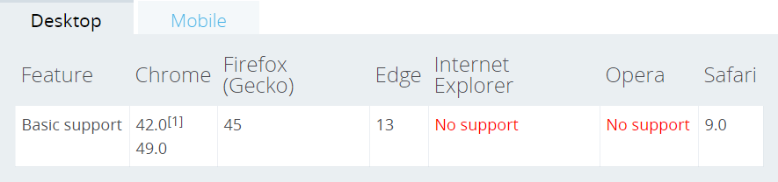
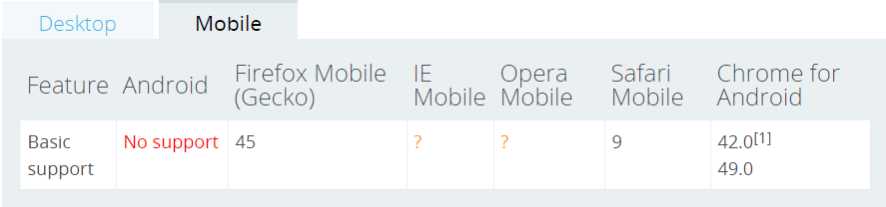
ECMAScript 6 & TypeScript
Browser Compatibility - Classes
copyright 2016 Trainologic LTD

Slide 52
ECMAScript 6 & TypeScript
Classes & TS
TypeScript’s classes have some additional features which do not exist in ES6:
Types: covered in previous section
Properties: class value members (as opposed to methods)
Access Modifiers* determine accessibility to class members:
* At runtime these have no significance, but will raise errors in compile time if you incorrectly used.
Accessible On | public | private | protected
Class instances | yes | no | no
Class | yes | yes | yes
Class children | yes | no | yes
copyright 2016 Trainologic LTD

Slide 53
ECMAScript 6 & TypeScript
Classes – TS - Example
  class Point {
  x: number;
  y: number;
  static instances: number = 0;
  constructor(x: number, y: number) {
  this.x = x;
  this.y = y;
  Point.instances++;
  }
  add(point: Point) {
  return new Point(this.x + point.x, this.y + point.y);
  }
  static printNumInstances() {
  console.log("There are " + Point.instances + " points");
  }
  }
  var p1 = new Point(0, 10);
  var p2 = new Point(10, 20);
  var p3 = p1.add(p2); // {x:10,y:30}
  Point.printNumInstances(); // There are 3 points
copyright 2016 Trainologic LTD

Slide 54
ECMAScript 6 & TypeScript
Classes – TS - Transpiled
class Point {
x: number;
y: number;
static instances: number = 0;
constructor(x: number, y: number) {
this.x = x;
this.y = y;
Point.instances++;
}
add(point: Point) {
return new Point(
this.x + point.x, this.y + point.y);
}
static printNumInstances() {
console.log("There are " +
Point.instances + " points");
}
}
var Point = (function () {
function Point (x, y) {
Point.instances++;
}
Point.prototype.add = function (point) {
return new Point(
this.x + point.x, this.y + point.y);
};
Point.printNumInstances = function () {
console.log("There are " +
Point.instances + " points");
};
Point.instances = 0;
return Point;
}());
copyright 2016 Trainologic LTD

Slide 55
ECMAScript 6 & TypeScript
Classes – Define Using Constructor
A very common class member initialization is:
TS thus provides a convenient shorthand annotation that does the same:
  class Foo {
  x: number;
  constructor(x:number) {
  this.x = x;
  }
  }
  class Foo {
  constructor(public x:number) {
  }
  }
copyright 2016 Trainologic LTD

Slide 56
ECMAScript 6 & TypeScript
Define Using Constructor – TS - Transpiled
class Foo {
constructor(public x:number) {
}
}
var Foo = (function () {
function Foo(x) {
this.x = x;
}
return Foo;
}());
copyright 2016 Trainologic LTD

Slide 57
ECMAScript 6 & TypeScript
Enumerable Types
Modules
Types
Types
Iterators
Generators
Promises
Maps, Sets & Friends
Iterators
copyright 2016 Trainologic LTD

Slide 58
ECMAScript 6 & TypeScript
Iterators
Iterators are a Behavioral Design Pattern common for OOP languages
Used for processing/going over collations, which is a very common task
Iterators bring the iteration concept directly into core JS
Provide a mechanism for customizing the behavior of for…of loops
Iterators are objects that know how to access collection items one at a time, keeping track of the current item
An iterator’s next() method returns an object with two properties:
  done – boolean indicating whether no more items left
  value – the item value
copyright 2016 Trainologic LTD

Slide 59
ECMAScript 6 & TypeScript
Example
  function makeOddIterator (array){
  var nextIndex = 0;
  return { // the iterator
  next: function() {
  var retval = nextIndex < array.length ? {value: array[nextIndex], done: false} : {done: true};
  nextIndex += 2;
  return retval;
  }
  }
  }
  var iter = makeOddIterator(['one', 'two', 'three', 'four', 'five', 'six', 'seven', 'eight']);
  for (var item = iter.next(); !item.done; item = iter.next()) {
  console.log(item.value);
  }
  // one, three, five, seven
copyright 2016 Trainologic LTD

Slide 60
ECMAScript 6 & TypeScript
Iterables
An object is iterable if it defines its iteration behavior
  Such as which values are looped over in a for..of construct
To be iterable, an object must implement the @@iterator method
Some built-in types, such as Array or Map, have a default iteration behavior (e.g. Array, Map, String), while others (e.g Object) do not
Some statements and expressions actually expect iterables:
  for(let value of ["a", "b", "c"]){ // for...of loop
  // ...
  }
  [..."abc"]; // ["a", "b", "c"] // spread operator
  [a, b, c] = new Set(["a", "b", "c"]); // destructuring assignment
copyright 2016 Trainologic LTD

Slide 61
ECMAScript 6 & TypeScript
User Defined Iterable - ES6
  let iterable = {
  0: 'a',
  1: 'b',
  2: 'c',
  length: 3,
  [Symbol.iterator]() {
  let index = 0;
  return {
  next: () => {
  let value = this[index];
  let done = index >= this.length;
  index++;
  return { value, done };
  }
  };
  }
  };
  for (let item of iterable) {
  console.log(item); // 'a', 'b', 'c'
  }
copyright 2016 Trainologic LTD

Slide 62
ECMAScript 6 & TypeScript
User Defined Iterable - TS
  class IterableStuffCollection implements IterableIterator<any> {
  private pointer = 0;
  constructor(private stuff:any[]) { }
  public next():IteratorResult<any> {
  let value = this.stuff[this.pointer];
  let done = this.pointer >= this.stuff.length;
  this.pointer++;
  return {value, done};
  }
  [Symbol.iterator]():IterableIterator<any> {
  return this;
  }
  }
  var myStuff = new IterableStuffCollection(['XBox One', 42, Math.PI, 'pokemon go', {oh: 'yeah'}]);
  for (let item of myStuff) {
  console.log(item);
  }
  // XBox One, 42, 3.141592653589793, pokemon go, { oh: 'yeah' }
copyright 2016 Trainologic LTD

Slide 63
ECMAScript 6 & TypeScript
User Defined Iterable – TS - Notes
Previous code example require ES6 target
It could also work with ES5 target, but will require:
  JS engine supporting Symbol.iterator (nodejs 4+, Google Chrome)
  Using ES6 lib with ES5 target (add es6.d.ts to your project)
  // tsconfig.json
  "compilerOptions": {
  "target": "ES6“
  }
  // lib.es6.d.ts
  interface IterableIterator<T> extends Iterator<T> {
  [Symbol.iterator](): IterableIterator<T>;
  }
copyright 2016 Trainologic LTD

Slide 64
ECMAScript 6 & TypeScript
TS Transpiled Code
  class IterableStuffCollection {
  constructor(stuff) {
  this.stuff = stuff;
  this.pointer = 0;
  }
  next() {
  let value = this.stuff[this.pointer];
  let done = this.pointer >= this.stuff.length;
  this.pointer++;
  return { value: value, done: done };
  }
  [Symbol.iterator]() { // note that ES6 Symbol.iterator / iteration protocol is required
  return this;
  }
  }
  var myStuff = new IterableStuffCollection(['XBox One', 42, Math.PI, 'pokemon go', { oh: 'yeah' }]);
  for (let item of myStuff) {
  console.log(item);
  }
copyright 2016 Trainologic LTD

Slide 65
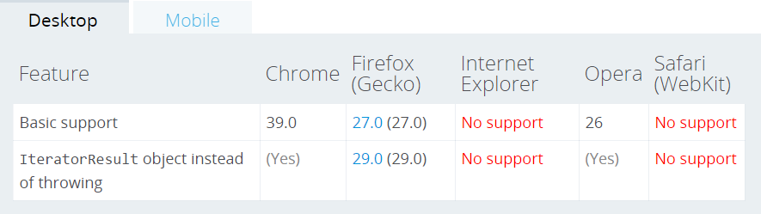
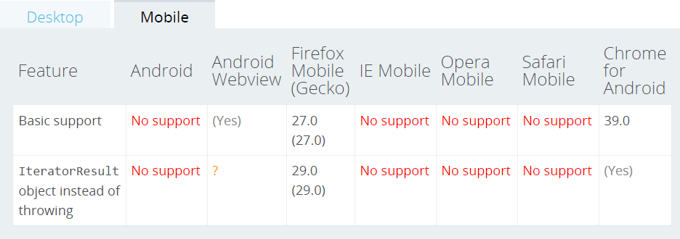
ECMAScript 6 & TypeScript
Browser Compatibility
copyright 2016 Trainologic LTD

Slide 66
ECMAScript 6 & TypeScript
Enumerable Types
Modules
Types
Types
Iterators
Generators
Promises
Maps, Sets & Friends
Generators
copyright 2016 Trainologic LTD

Slide 67
ECMAScript 6 & TypeScript
Generators
Generators are a new breed of functions in JS, with a new syntax:
function *
Calling a generator function does not execute its body immediately
  Instead, an iterator object for the function is returned
We then iterate the generator by repeatedly calling next()
next() executes the body function until the next yield expression returns a value
Since the generator is really a function, we can call next() with arguments
Execution can be further delegated to another generator function using a yield * generator expression
copyright 2016 Trainologic LTD

Slide 68
ECMAScript 6 & TypeScript
Generators - Motivation
Lazy Iterators – examples:
  Return a finite or infinite list of values
  Lazy execution/loading
Externally Controlled Execution
  Allows a function to pause execution and pass control to the caller
  Re-entering the function again later, while keeping context (variable bindings) across re-entrances
  We can control its behavior by passing arguments to the generator
copyright 2016 Trainologic LTD

Slide 69
ECMAScript 6 & TypeScript
Generators – Lazy Iteration
  function* idMaker() { // generator function
  var index = 0;
  while(index < 3) // note this is a finite iterator
  yield index++;
  }
  var gen = idMaker(); // returns iterator
  console.log(gen.next().value); // 0
  console.log(gen.next().value); // 1
  console.log(gen.next().value); // 2
  console.log(gen.next().value); // undefined
dsds
copyright 2016 Trainologic LTD

Slide 70
ECMAScript 6 & TypeScript
Generators – Function Args
  function* addCallNumber (base) {
  var callNumber = 0;
  while (true) {
  yield base + callNumber++;
  }
  }
  var gen = addCallNumber(10); // invoke generator with argument(s)
  console.log(gen.next().value); // 10
  console.log(gen.next().value); // 11
  console.log(gen.next().value); // 12
dsds
copyright 2016 Trainologic LTD

Slide 71
ECMAScript 6 & TypeScript
Passing Arguments Into Generators
"use strict";
function* showPrevCurrGenerator() {
var prev, curr;
while (true) {
console.log('-------');
prev = curr;
curr = yield;
console.log('prev = ' + prev);
console.log('curr = ' + curr);
}
}
var gen = showPrevCurrGenerator();
gen.next(); // executes until the first yield
gen.next('First');
gen.next('Second');
gen.next('Third');
dsds
  -------
  prev = undefined
  curr = First
  -------
  prev = First
  curr = Second
  -------
  prev = Second
  curr = Third
  -------
copyright 2016 Trainologic LTD

Slide 72
ECMAScript 6 & TypeScript
Generators – yield*
  function* anotherGenerator(i) {
  yield i + 0.1;
  yield i + 0.2;
  yield i + 0.3;
  }
  function* generator(i){
  yield '0.01';
  yield* anotherGenerator(i);
  yield i * 10;
  }
  var gen = generator(10);
  console.log(gen.next().value); // 0.01
  console.log(gen.next().value); // 10.1
  console.log(gen.next().value); // 10.2
  console.log(gen.next().value); // 10.3
  console.log(gen.next().value); // 100
dsds
copyright 2016 Trainologic LTD

Slide 73
ECMAScript 6 & TypeScript
TS Transpiled Code
  // This is a pure ES6 feature, TS doesn't do any magic
  // Generators require ES6 support in the browser/node
  function* idMaker() {
  var index = 0;
  while (index < 3) {
  yield index++;
  }
  }
copyright 2016 Trainologic LTD

Slide 74
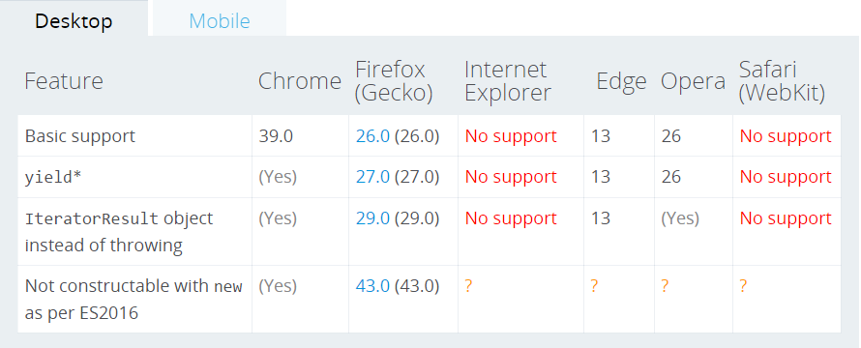
ECMAScript 6 & TypeScript
Browser Compatibility - Desktop
copyright 2016 Trainologic LTD

Slide 75
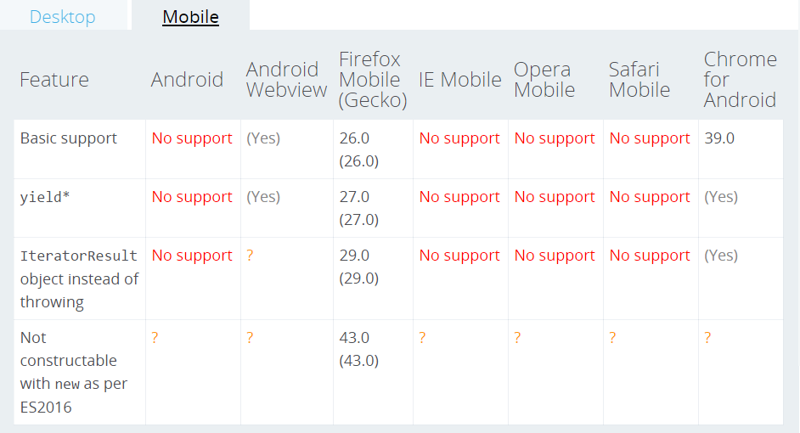
ECMAScript 6 & TypeScript
Browser Compatibility - Mobile
copyright 2016 Trainologic LTD

Slide 76
ECMAScript 6 & TypeScript
Enumerable Types
Modules
Types
Types
Iterators
Generators
Promises
Maps, Sets & Friends
Promises
copyright 2016 Trainologic LTD

Slide 77
ECMAScript 6 & TypeScript
Promises
A Promise represents an operation that hasn't completed yet, but is expected in the future
Used for asynchronous computations
Promises are chainable. This is a key benefit
Syntax:
new Promise(function(resolve, reject) { ... } );
The promise Ctor takes a single argument: an executor function
    Executed immediately (even before returning the new Promise object)
    resolve and reject functions are bound to the promise and calling them fulfills or rejects the promise, respectively
    The executor function is expected to initiate some async work, and then invoke either resolve or reject
copyright 2016 Trainologic LTD

Slide 78
ECMAScript 6 & TypeScript
Promise States
Pending
With a value
With a reason
Fulfilled
Rejected
SETTLED
copyright 2016 Trainologic LTD

Slide 79
ECMAScript 6 & TypeScript
Methods - then
Promise.then(onFulfilled, onRejected)
  Appends fulfillment and rejection handlers to the promise
  Returns a new promise resolving to
    The return value of the called handler (onFulfilled / onRejected)
    Or to its original settled value if the promise was not handled (i.e. if the relevant handler onFulfilled or onRejected are not a function)
  We say that promises are “thenable” objects
  Allows us to create chains since then() returns a promise
    We call this “composition”
copyright 2016 Trainologic LTD

Slide 80
ECMAScript 6 & TypeScript
Methods – catch
Promise.catch(onRejected)
  Appends a rejection handler callback to the promise
  Returns a new promise resolving to
    The return value of the callback if it is called
    Or to original fulfillment value if the promise is fulfilled
  Allows us to create chains since catch() returns a promise
copyright 2016 Trainologic LTD

Slide 81
ECMAScript 6 & TypeScript
Methods – Other
Promise.all(iterable)
  Takes a list of promises and returns a promise that
      Resolves when all promises resolve
      Or rejects as soon as any promise fails
Promise.race(iterable)
  Takes a list of promises and returns a promise that
    Resolves as soon as any promise resolves
    Or rejects as soon as any promise rejects
Promise.resolve(value) / Promise.reject(reason)
  Shortcuts returning an already resolved/rejected promise
  Useful for example for initiating a chain
copyright 2016 Trainologic LTD

Slide 82
ECMAScript 6 & TypeScript
Example - Chaining
  Promise.resolve(123)
  .then((res) => {
  console.log(res); // 123
  return 456;
  })
  .then((res) => {
  console.log(res); // 456
  return Promise.resolve(123);
  })
  .then((res) => {
  console.log(res); // 123 : Notice `this` is called with the resolved value
  return Promise.resolve(123);
  })
dsds
copyright 2016 Trainologic LTD

Slide 83
ECMAScript 6 & TypeScript
Example – Aggregated Error Handling
  Promise.reject(new Error('something bad happened'))
  .then((res) => {
  console.log(res); // not called
  return 456;
  })
  .then((res) => {
  console.log(res); // not called
  return Promise.resolve(123);
  })
  .then((res) => {
  console.log(res); // not called
  return Promise.resolve(123);
  })
  .catch((err) => {
  console.log(err.message); // something bad happened
  });
dsds
copyright 2016 Trainologic LTD

Slide 84
ECMAScript 6 & TypeScript
Example – catch Chaining
  Promise.reject(new Error('something bad happened'))
  .then((res) => {
  console.log(res); // not called
  return 456;
  })
  .catch((err) => {
  console.log(err.message); // something bad happened
  return Promise.resolve(123);
  })
  .then((res) => {
  console.log(res); // 123
  });
dsds
copyright 2016 Trainologic LTD

Slide 85
ECMAScript 6 & TypeScript
TS & Promises
TS understands promises flow of values
  Promise.resolve(123)
  .then((res)=>{
  // res is inferred to be of type `number`
  return true;
  })
  .then((res) => {
  // res is inferred to be of type `boolean`
  });
copyright 2016 Trainologic LTD

Slide 86
ECMAScript 6 & TypeScript
TS & Promises – cont.
TS also understands unwrapping function calls that return a promise
  function iReturnPromiseAfter1Second():Promise<string> {
  return new Promise((resolve)=>{
  setTimeout(()=>resolve("Hello world!"), 1000);
  });
  }
  Promise.resolve(123)
  .then((res)=>{
  // res is inferred to be of type `number`
  return iReturnPromiseAfter1Second();
  })
  .then((res) => {
  // res is inferred to be of type `string`
  console.log(res); // Hello world!
  });
copyright 2016 Trainologic LTD

Slide 87
ECMAScript 6 & TypeScript
TS – Converting CB to Promise
  import fs = require('fs');
  function readFileAsync (filename:string):Promise<any> {
  return new Promise((resolve,reject)=> {
  fs.readFile(filename,(err,result) => {
  if (err) reject(err);
  else resolve(result);
  });
  });
  }
dsds
copyright 2016 Trainologic LTD

Slide 88
ECMAScript 6 & TypeScript
TS – Transpiled Code
TS does not do any “magic” with promises
It relies on ES6 promises or a polyfill
  function iReturnPromiseAfter1Second() {
  return new Promise((resolve) => {
  setTimeout(() => resolve("Hello world!"), 1000);
  });
  }
  Promise.resolve(123)
  .then((res) => {
  return iReturnPromiseAfter1Second();
  })
  .then((res) => {
  console.log(res); // Hello world!
  });
copyright 2016 Trainologic LTD

Slide 89
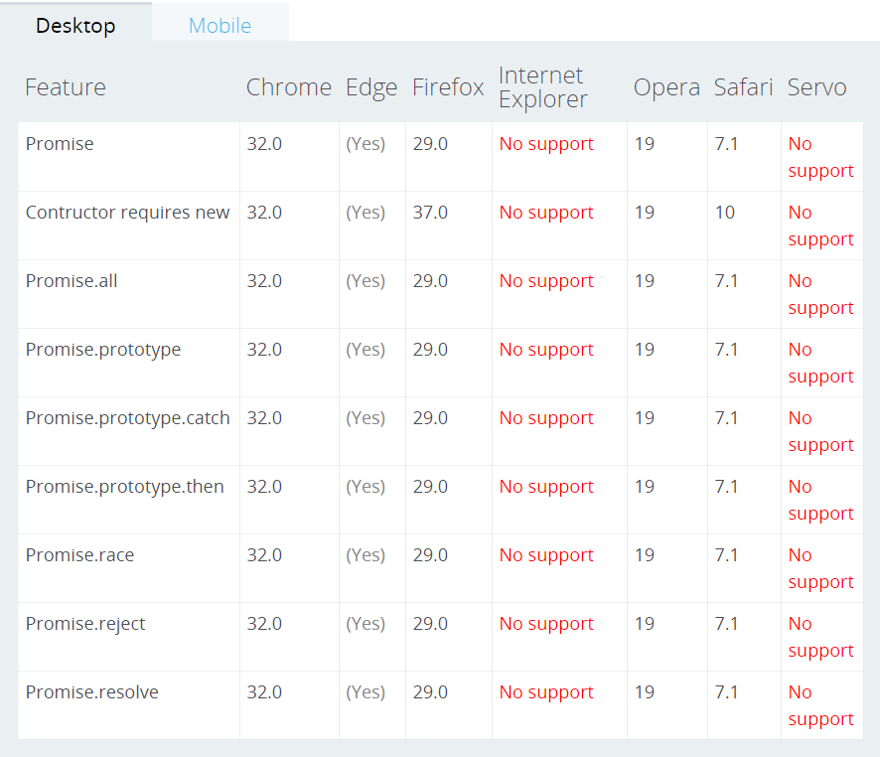
ECMAScript 6 & TypeScript
Browser Compatibility - Desktop
copyright 2016 Trainologic LTD

Slide 90
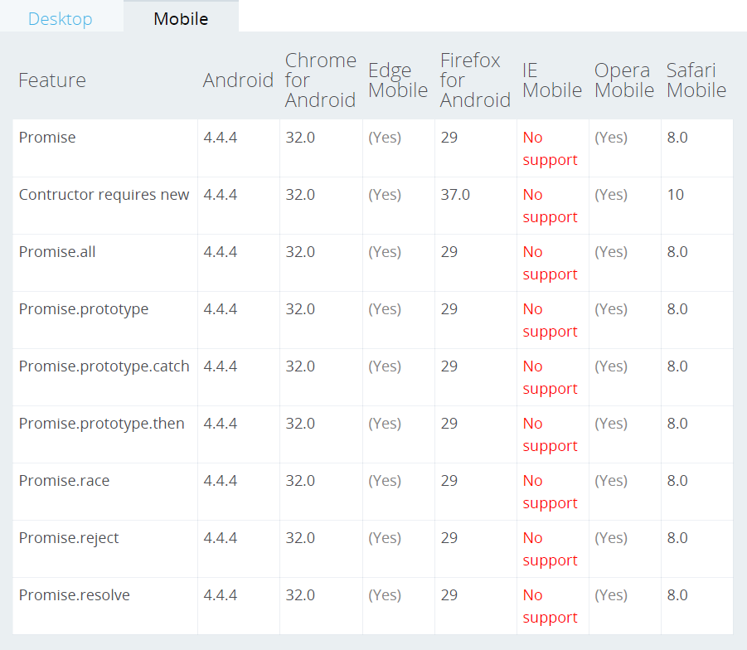
ECMAScript 6 & TypeScript
Browser Compatibility - Mobile
copyright 2016 Trainologic LTD

Slide 91
ECMAScript 6 & TypeScript
Enumerable Types
Modules
Types
Types
Iterators
Generators
Promises
Maps, Sets & Friends
Maps, Sets & Friends
copyright 2016 Trainologic LTD

Slide 92
ECMAScript 6 & TypeScript
Maps
The Map object is a simple key/value dictionary
Any value (both objects and primitive values) may be used as either a key or a value
Syntax:
new Map([iterable])
Iterable is an optional other iterable object whose elements are key-value pairs
for…of looping on a map returns an [key, value] array (in insertion order) each iteration
Key equality is based on “same value” algorithm
  NaN is considered same as Nan (although in JS they’re not)
  All other values go by the === semantics
copyright 2016 Trainologic LTD

Slide 93
ECMAScript 6 & TypeScript
Maps vs. JS Objects
Similar in that both let us set/retrieve/delete/check values by keys
The main differences are:
  An Object has a prototype, so we might have default keys
  Object keys are Strings or Symbols, but can be any value for Map
  Map’s size can be retrieved easily, difficult with an Object
Still, in many cases it is perfectly okay to continue using Objects
copyright 2016 Trainologic LTD

Slide 94
ECMAScript 6 & TypeScript
Map Properties & Methods
size – Returns the number of k/v pairs in the Map object
clear() – Removes all k/v pairs
delete(key) – Removes value, returns true/false if deleted/not-found
entries() – returns a new Iterator containing an array of [k,v] pairs per each iteration, in insertion order
keys() – Returns a new Iterator containing keys in insertion order
values() – Returns a new Iterator containing values in insertion order
forEach(cbFn [, this]) – calls cbFn for each k/v pair in insertion order. If this is provided, will be applied to cbFn
has(k) – Returns true if key exists in the Map
get(k) – Returns the value if key k exists, undefined otherwise
set(k, v) – Sets the value for the key, returns the Map (for chaining)
[@@iterator]() – Returns a new Iterator containing [k,v] array for each element in insertion order
copyright 2016 Trainologic LTD

Slide 95
ECMAScript 6 & TypeScript
Maps – Example: Simple
  var myMap = new Map();
  var keyString = "a string",
  keyObj = {},
  keyFunc = function () {};
  // setting the values
  myMap.set(keyString, "value associated with 'a string'");
  myMap.set(keyObj, "value associated with keyObj");
  myMap.set(keyFunc, "value associated with keyFunc");
  myMap.size; // 3
  // getting the values
  myMap.get(keyString); // "value associated with 'a string'"
  myMap.get(keyObj); // "value associated with keyObj"
  myMap.get(keyFunc); // "value associated with keyFunc"
  myMap.get("a string"); // "value associated with 'a string‘” because keyString === 'a string'
  myMap.get({}); // undefined, because keyObj !== {}
  myMap.get(function() {}) ; // undefined, because keyFunc !== function () {}
dsds
copyright 2016 Trainologic LTD

Slide 96
ECMAScript 6 & TypeScript
Maps – Example: Iterating
  var myMap = new Map();
  myMap.set(0, "zero");
  myMap.set(1, "one");
  for (var [key, value] of myMap) { // 0 = zero, 1 = one
  console.log(key + " = " + value);
  }
  for (var key of myMap.keys()) { // 0, 1
  console.log(key);
  }
  for (var value of myMap.values()) { // zero, one
  console.log(value);
  }
  for (var [key, value] of myMap.entries()) { // 0 = zero, 1 = one
  console.log(key + " = " + value);
  }
  myMap.forEach(function(value, key) { // 0 = zero, 1 = one
  console.log(key + " = " + value);
  });
dsds
copyright 2016 Trainologic LTD

Slide 97
ECMAScript 6 & TypeScript
TS – Transpiled Code
TS does not do any “magic” with Maps
It relies on ES6 Maps or a polyfill
  var myMap = new Map();
  myMap.set(0, "zero");
  myMap.set(1, "one");
  for (var [key, value] of myMap) {
  console.log(key + " = " + value);
  }
  for (var key of myMap.keys()) {
  console.log(key);
  }
  for (var value of myMap.values()) {
  console.log(value);
  }
  for (var [key, value] of myMap.entries()) {
  console.log(key + " = " + value);
  }
  myMap.forEach(function (value, key) {
  console.log(key + " = " + value);
  });
copyright 2016 Trainologic LTD

Slide 98
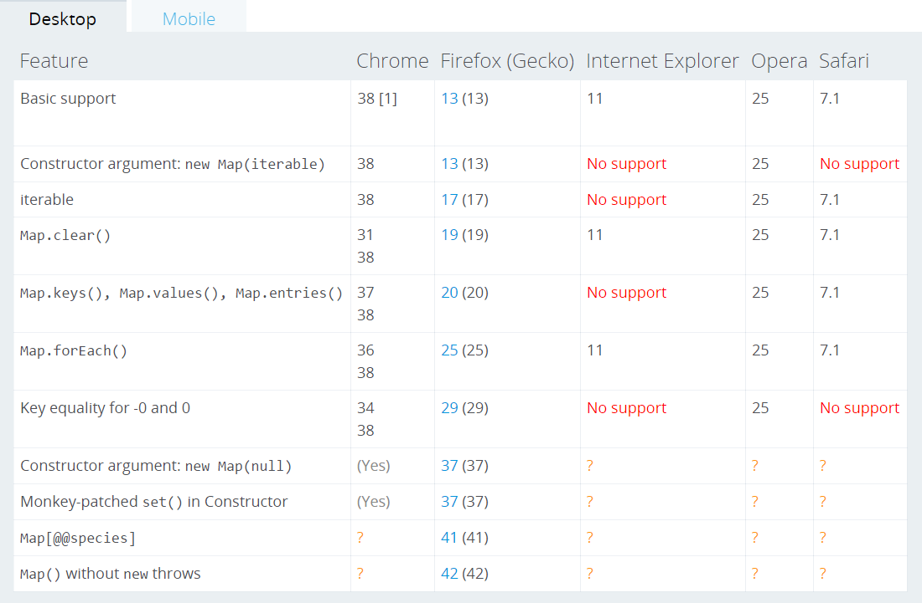
ECMAScript 6 & TypeScript
Browser Compatibility - Desktop
copyright 2016 Trainologic LTD

Slide 99
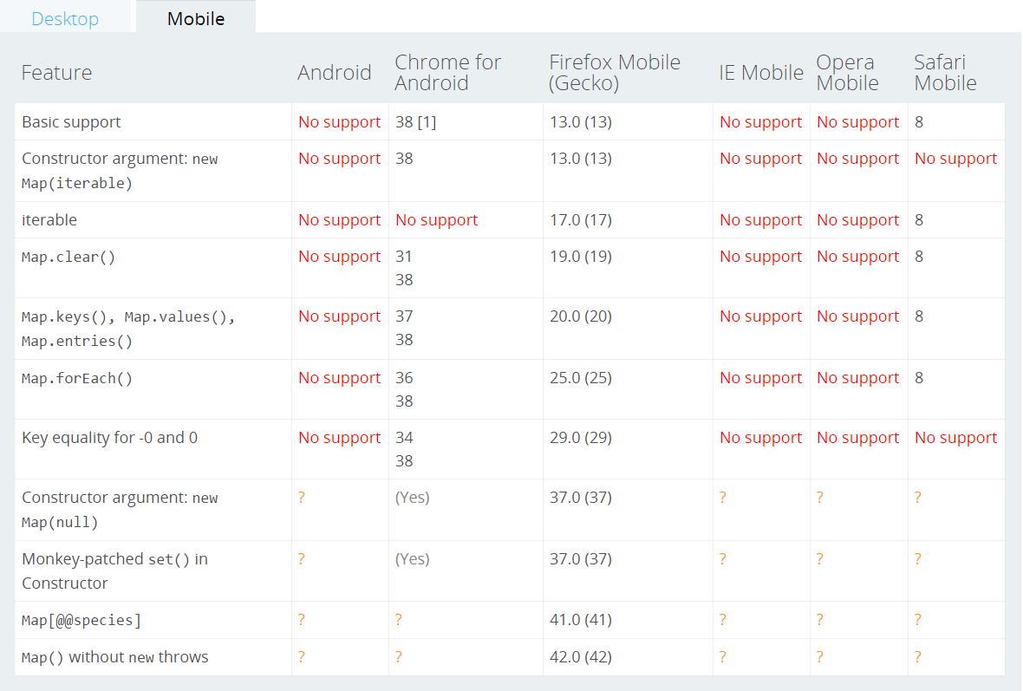
ECMAScript 6 & TypeScript
Browser Compatibility - Mobile
copyright 2016 Trainologic LTD

Slide 100
ECMAScript 6 & TypeScript
Sets
Set objects are collections of values, which we can iterate according to insertion order
Sets let us store unique values of any type, whether primitive values or object references
Syntax:
new Set([iterable])
If an iterable object is passed, all of its elements will be added to the new Set
Value equality is similar to ===
two objects are equal only if they
refer to the exact same object
var set = new Set();
set.add({a:1});
set.add({a:1});
console.log(set.size) // 2
console.log([...set.values()]); // Array [ Object, Object ]
copyright 2016 Trainologic LTD

Slide 101
ECMAScript 6 & TypeScript
Set Properties & Methods
size – Returns the number of elements pairs in the Set object
add() – Appends a new element
clear() – Removes all elements from the Set object
delete(value) – Removes element and returns true/false if value existed(deleted) or not
entries() – Returns a new Iterator object containing an array of [value, value] for each element, in insertion order
forEach(cbFn [, this]) – Calls cbFn for each value in the Set object in insertion order. If this is provided – will be applied to cbFn
has(value) – Returns a boolean indicating whether value exists
values() – Returns a new Iterator containing all element values
keys() – Same as values()
[@@iterator]() – Returns a new Iterator containing all values in insertion order
copyright 2016 Trainologic LTD

Slide 102
ECMAScript 6 & TypeScript
Sets – Example: Simple
  var mySet = new Set();
  mySet.add(1);
  mySet.add(1); // does nothing, 1 is already in the set
  mySet.add(5);
  mySet.add("some text");
  var o = {a: 1, b: 2};
  mySet.add(o);
  mySet.has(1); // true
  mySet.has(3); // false
  mySet.has(Math.sqrt(25)); // true (5 exists)
  mySet.has("Some Text".toLowerCase()); // true
  mySet.has(o); // true
  mySet.size; // 4
  mySet.delete(5); // removes 5 and returns true (5 existed before deletion)
  mySet.has(5); // false, 5 has been removed
  mySet.size; // 3, we just removed one value
dsds
copyright 2016 Trainologic LTD

Slide 103
ECMAScript 6 & TypeScript
Sets – Example: Iterating
// ... continuing our previous example
for (let item of mySet) console.log(item); // 1, some text, Object {a: 1, b: 2}
for (let item of mySet.keys()) console.log(item); // 1, some text, Object {a: 1, b: 2}
for (let item of mySet.values()) console.log(item); // 1, some text, Object {a: 1, b: 2}
for (let [key, value] of mySet.entries()) console.log(key); // 1, some text, Object {a: 1, b: 2}
mySet.forEach(e => console.log(e)); // 1, some text, Object {a: 1, b: 2}
console.log([...mySet]); // [1, “some text”, Object]
dsds
copyright 2016 Trainologic LTD

Slide 104
ECMAScript 6 & TypeScript
TS – Transpiled Code
TS does not do any “magic” with Sets
It relies on ES6 Sets or a polyfill
  var mySet = new Set();
  mySet.add(1);
  mySet.add(5);
  mySet.add("some text");
  var o = { a: 1, b: 2 };
  mySet.add(o);
  mySet.has(1);
copyright 2016 Trainologic LTD

Slide 105
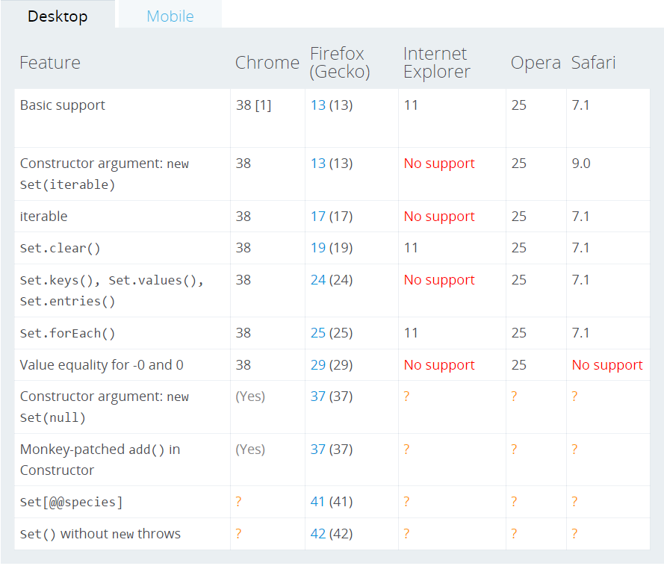
ECMAScript 6 & TypeScript
Browser Compatibility - Desktop
copyright 2016 Trainologic LTD

Slide 106
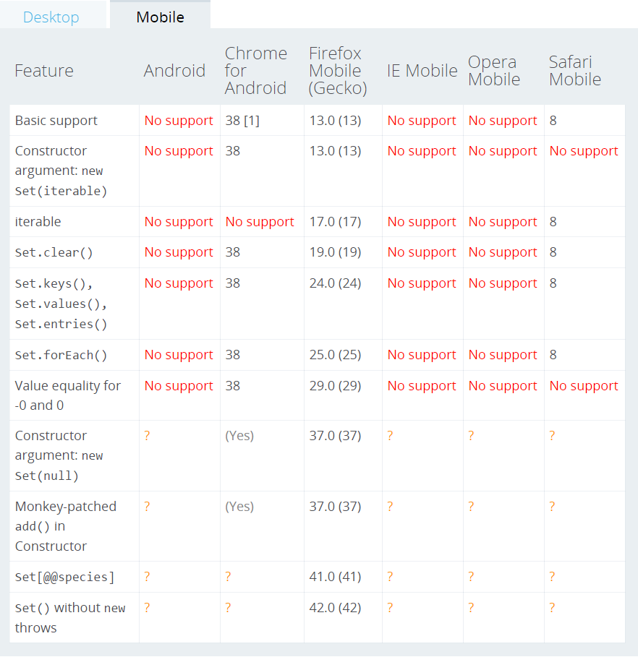
ECMAScript 6 & TypeScript
Browser Compatibility - Mobile
copyright 2016 Trainologic LTD

Slide 107
ECMAScript 6 & TypeScript
WeakMap & WeakSet
The “Weak” counterparts of Map and Set
Weakly hold references to keys/values stored
Adding an element to the collection does’nt increase reference count
When the element is freed up, the collection will no longer contain that element
Syntax:
new WeakMap([iterable])
new WeakSet([iterable])
copyright 2016 Trainologic LTD

Slide 108
ECMAScript 6 & TypeScript
WeakMap & WeakSet – Cont.
When there are no more references (in our code) to an object stored in the collection, it is garbage collected
That means there is no list of objects stored in the collection
Therefore weak collections are not enumarable
Available methods – WeakMap:
  delete(), get(key), has(key), set(key, value)
Available methods – WeakSet:
  add(value), get(value), has(value)
copyright 2016 Trainologic LTD

Slide 109
ECMAScript 6 & TypeScript
WeakMap - Example
  var wm = new WeakMap();
  var keys = {
  key1: {}
  };
  wm.set(keys.key1, "some value associated with key");
  console.log(wm.get(keys.key1)); // "some value associated with key"
  delete keys.key1; // we’ll now delete the key object
  console.log(wm.get(keys.key1)); // undefined
copyright 2016 Trainologic LTD

Slide 110
ECMAScript 6 & TypeScript
WeakSet - Example
  var ws = new WeakSet();
  var keys = {
  key1: {}
  };
  ws.add(keys.key1);
  console.log(ws.has(keys.key1)); // true
  delete keys.key1; // we'll now delete the key object
  console.log(ws.has(keys.key1)); // false
copyright 2016 Trainologic LTD

Slide 111
ECMAScript 6 & TypeScript
TS – Transpiled Code
TS does not do any “magic” with weak collections
It relies on the ES6 feature or polyfills
  var ws = new WeakSet();
  var wm = new WeakMap();
copyright 2016 Trainologic LTD

Slide 112
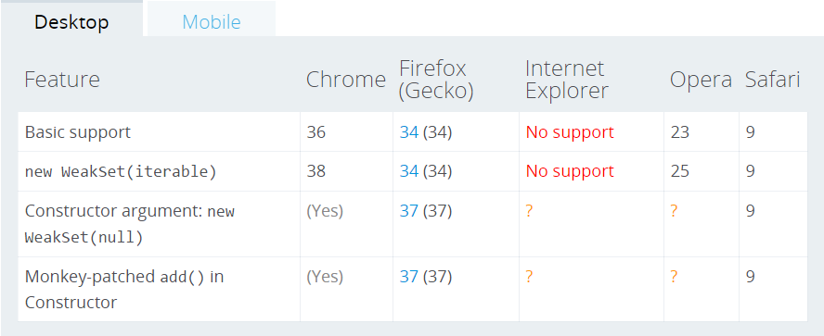
ECMAScript 6 & TypeScript
Browser Compatibility – WeakMap Desktop
copyright 2016 Trainologic LTD

Slide 113
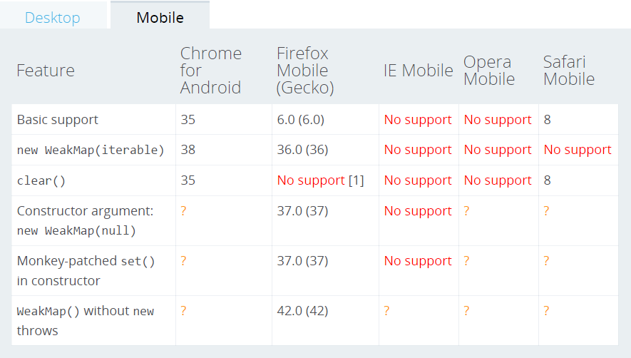
ECMAScript 6 & TypeScript
Browser Compatibility – WeakMap Mobile
copyright 2016 Trainologic LTD

Slide 114

ECMAScript 6 & TypeScript
Browser Compatibility – WeakSet Desktop
copyright 2016 Trainologic LTD

Slide 115
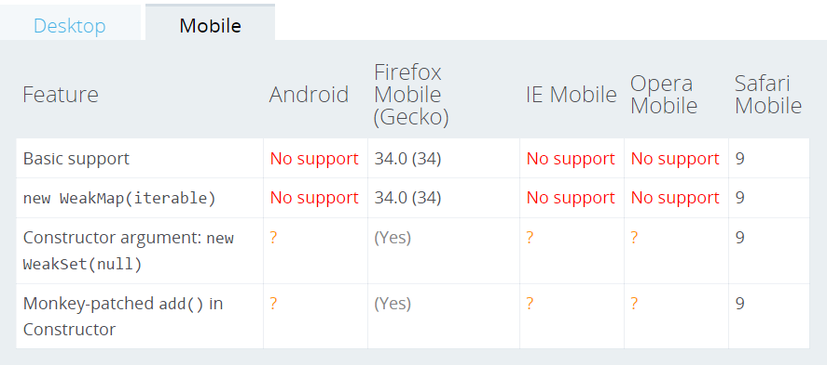
ECMAScript 6 & TypeScript
Browser Compatibility – WeakSet Mobile
copyright 2016 Trainologic LTD

Slide 116

ECMAScript 6 & TypeScript
copyright 2016 Trainologic LTD

